Slide 1

DATA CLEANING & TRANSFORMATION
EXCEL ASSIGNMENT-2 REPORT

Slide 2
“NO DATA IS CLEAN,
BUT MOST IS USEFUL.”
- DEAN ABBOTT

Slide 3
1.EXCUTIVE SUMMARY
This report documents the workflow and operations performed on the dateset, shown in excel assignment. The assignment focused on the transforming raw data to clean and processed data.

Slide 4
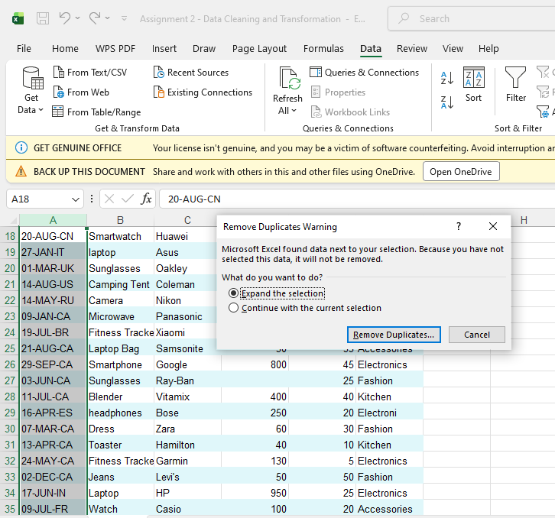
Tasks Performed:
1. Duplicates Cleaned:
As the first step of cleaning the raw
Data, Duplicates has been removed.
by selecting the unique id column
and selected remove duplicates
option from the data tab in the
Ribbon.

Slide 5
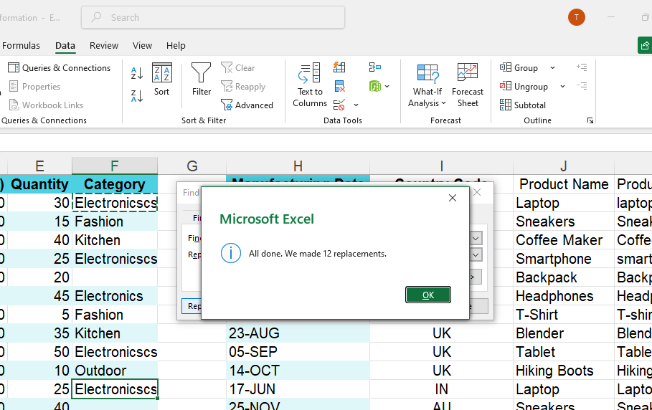
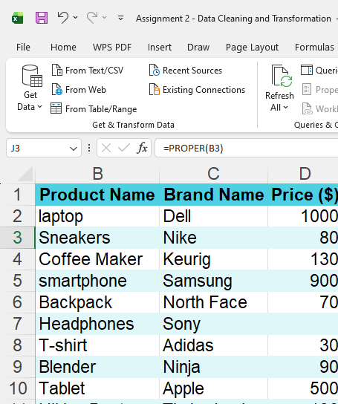
2. Correcting Inconsistent Data:
          Identified typos present in the category column and removed by find and replace options, shortscuts used: cntrl + H is used to find all the typos and replaced with the correct spelling. In the column b proper() function is used to align the column completely in the proper case.

Slide 6
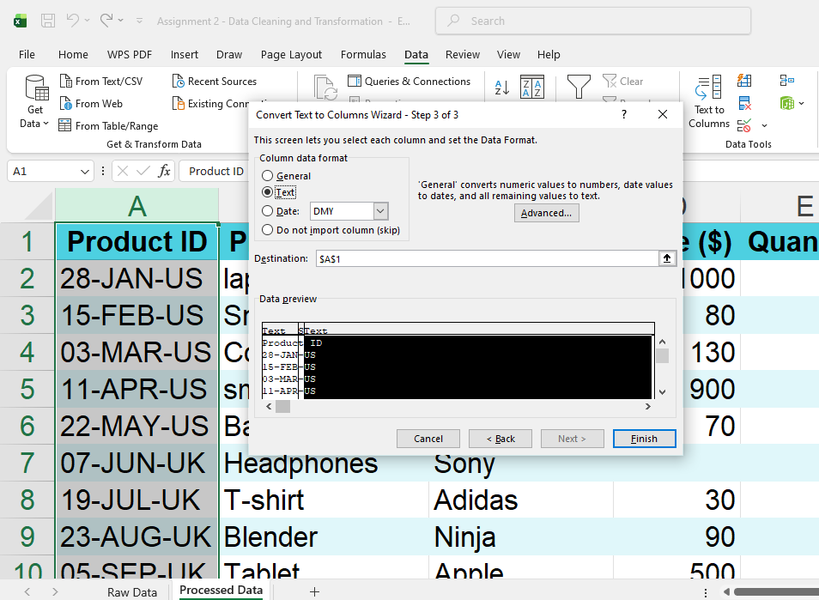
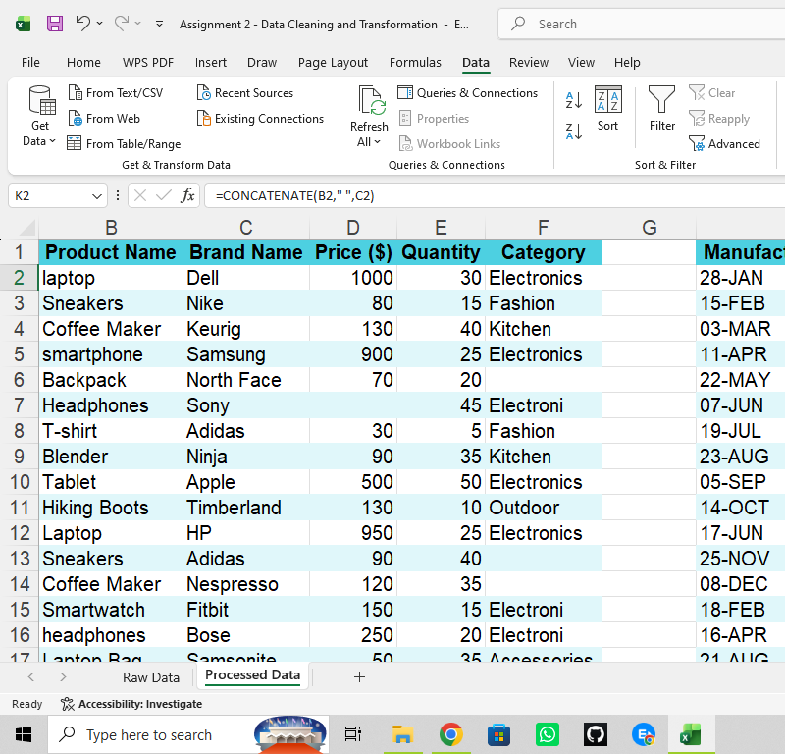
3. Splitting and Merging Data:
  Splitting: Product id column is splitted into two columns as Manufaturing date and Country code, by selectimg the column, in ribbon in data tab, in data tools group, text to column function is used in that select the fixied width and give next option and fix the width and change the general format to text format.
  Mergging: to merge two options canbe used oneis concatenate and other one is in home tab use merge .

Slide 7
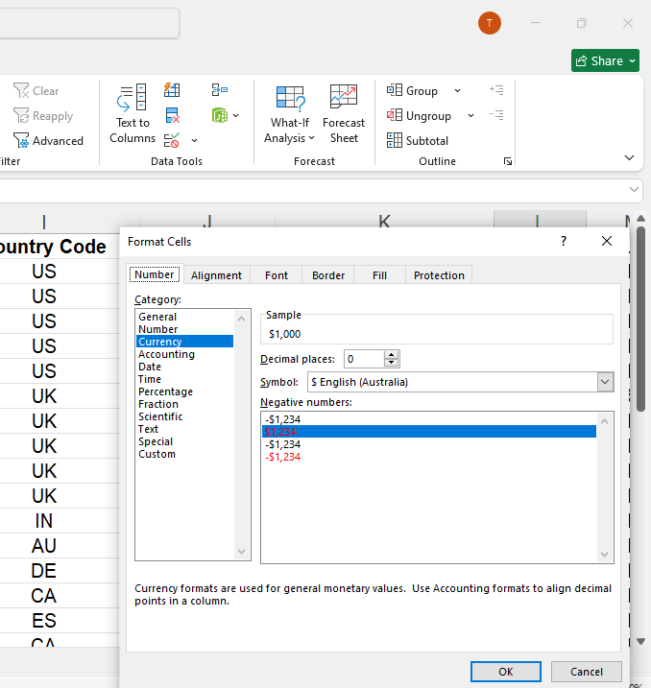
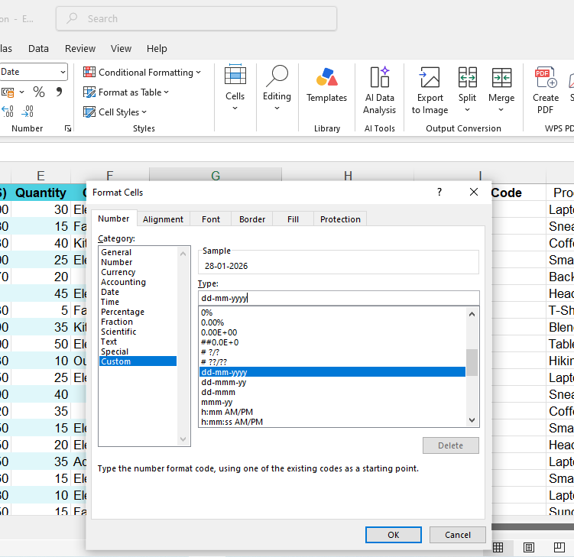
4.Number Formatting:
  In the number formatting options, two operations are done in the two different columns they are currency format in price column and the date format as “dd-mm-yyyy” in the manufacturing date column. By right clicking the cell and selecting formatting cell options and currency and date formation is done.

Slide 8
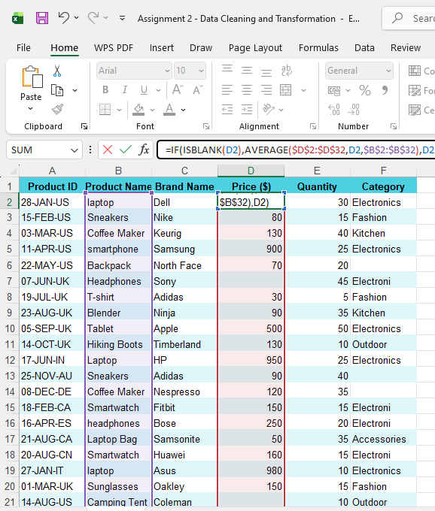
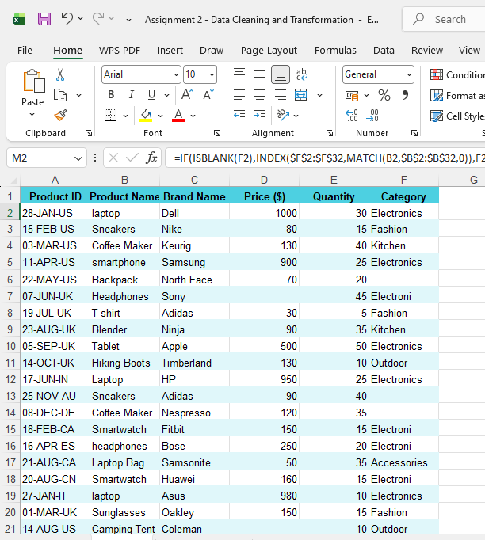
5. Handling missing Data:
  In the price column the missing data is handled imputation method by performing average to the similar data, formula used: =IF(ISBLANK(D2),AVERAGE($D$2:$D$32,D2,$B$2:$B$32),D2).
  In the category column the missing data is imputed in the own category and if, isblank, index, match formula is used, and math operation performed from top to bottom. =IF(ISBLANK(F2),INDEX($F$2:$F$32,MATCH(B2,$B$2:$B$32,0)),F2)

Slide 9
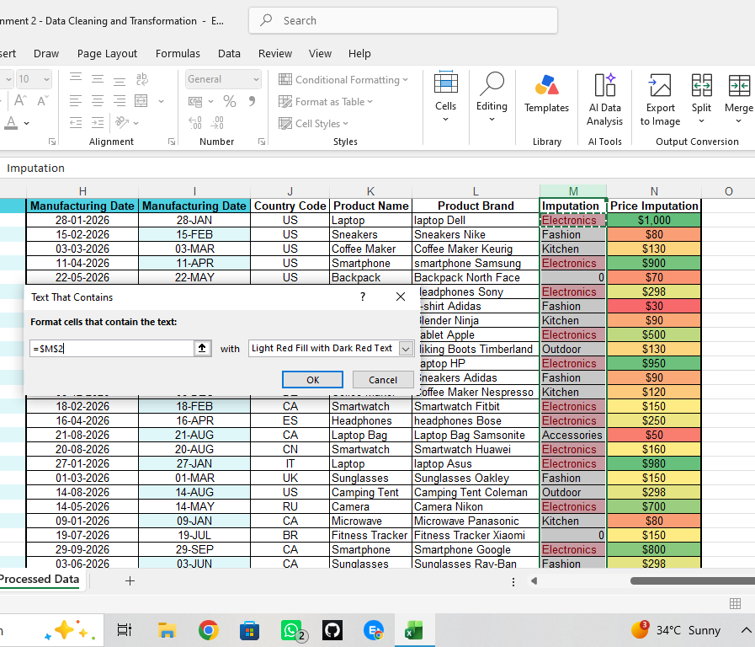
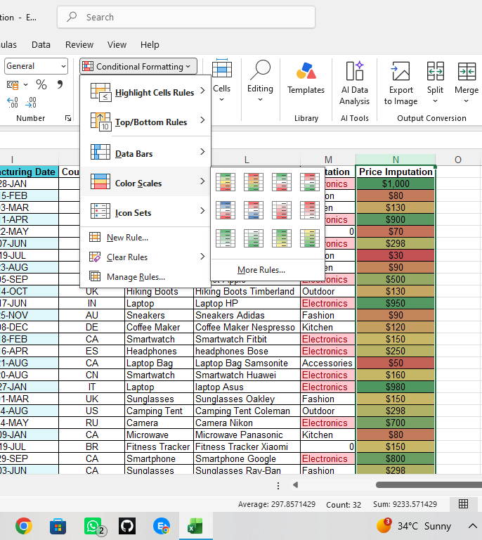
6.Conditional Formatting:
  In the home tab conditional formatting icon by clicking the drop down we can use format options for the particular column, for the price imputation column colour scale formatting is used and for the category column highlight cell rules in that text that contain formatting is used and changed the cell colour for the particular electronic word present in more than one cell.

Slide 10
CONCLUSION:
  The raw data was successfully cleaned, formatted, and organized using Microsoft Excel. Blank values are handled, categories were filled, and data consistency was improved. The final dataset is, structured and ready for analysis.

